Slide 1
Sampling chip 3
Jean-Francois Genat, Herve Grabas, Eric Oberla
August 2d 2010

Slide 2
Context
This chip aims to read Micro-Channel Plate devices coupled to
Transmission lines to provide large dimensions detectors with :
- 2-dimension readout with a 1mm precision (Δt=10ps)
- Time of flight timing 1-10ps

Slide 3
Sampling electronics
Fast sampling electronics
- Records all the information from the detector pulse
- Provide picosecond timing resolution
See - G. Varner
- S. Ritt
- D. Breton, E. Delagnes

Slide 4
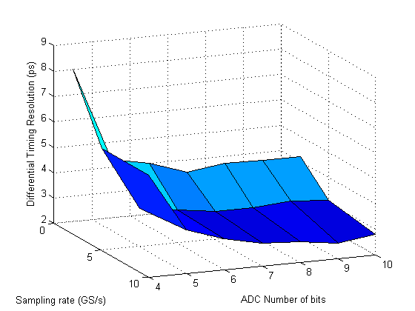
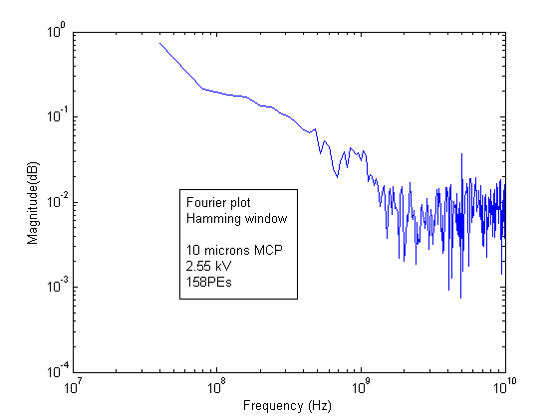
Timing resolution
Data taken at Argonne
(Ed May’s laser test stand)
Differential timing resolution from T-line readout (10um MCP tube, 160PEs) for:
2-10GS/s sampling rates,
1 GHz 3dB analog bandwidth,
- 4-10 bit ADC resolutions.
No need to go much beyond 10GS/s and 7 bit with present MCPs.

Slide 5
Guidelines
Push the 3dB analog bandwidth up to 1 GHz
Sampling rate up to 10-15GS/s
Digitize on-chip to 8-bit (and later signal process)
Use the130n same 130nm CMOS process

Slide 6
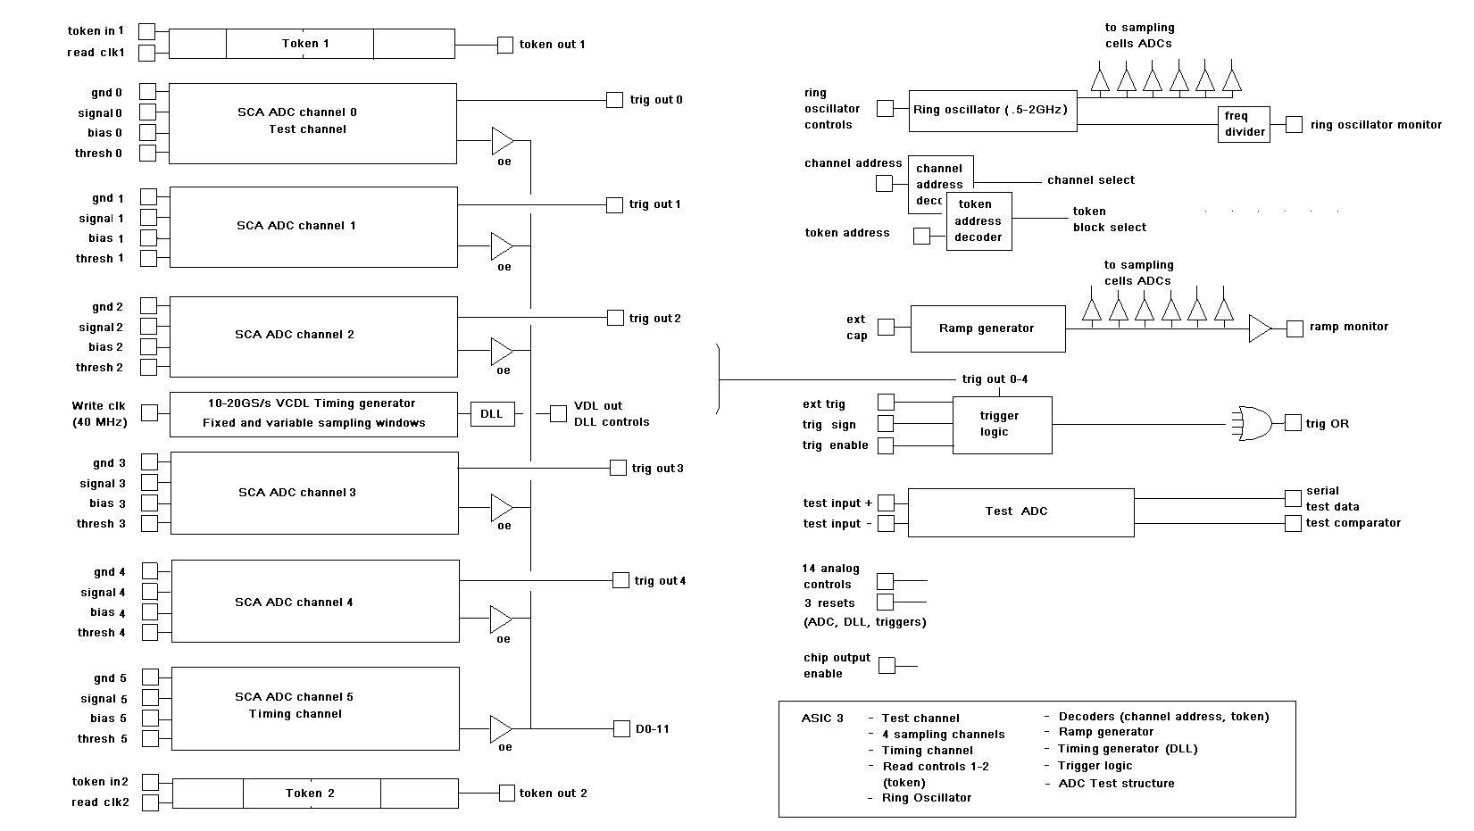
Block-diagram

