Slide 1
Conceptual Mechanical Design
C T A Camera Development
Rich Northrop Laboratory for Astrophysics & Space Research
University of Chicago
Consortium Meeting Chicago May 28 – June 1 2013
Vers3

Slide 2
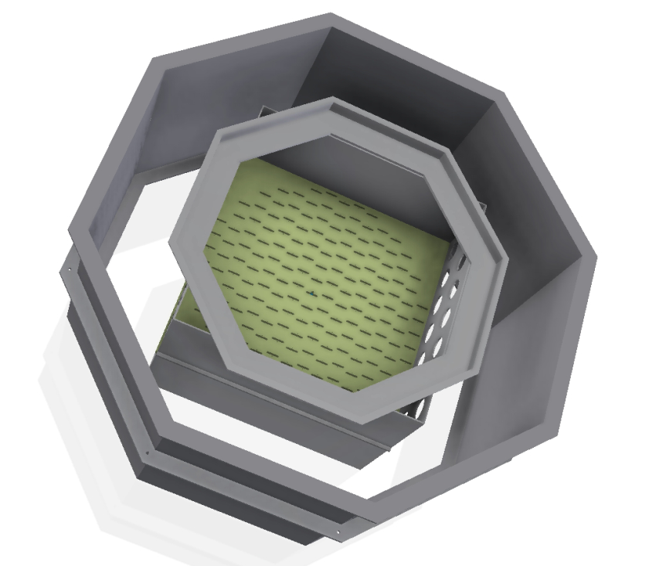
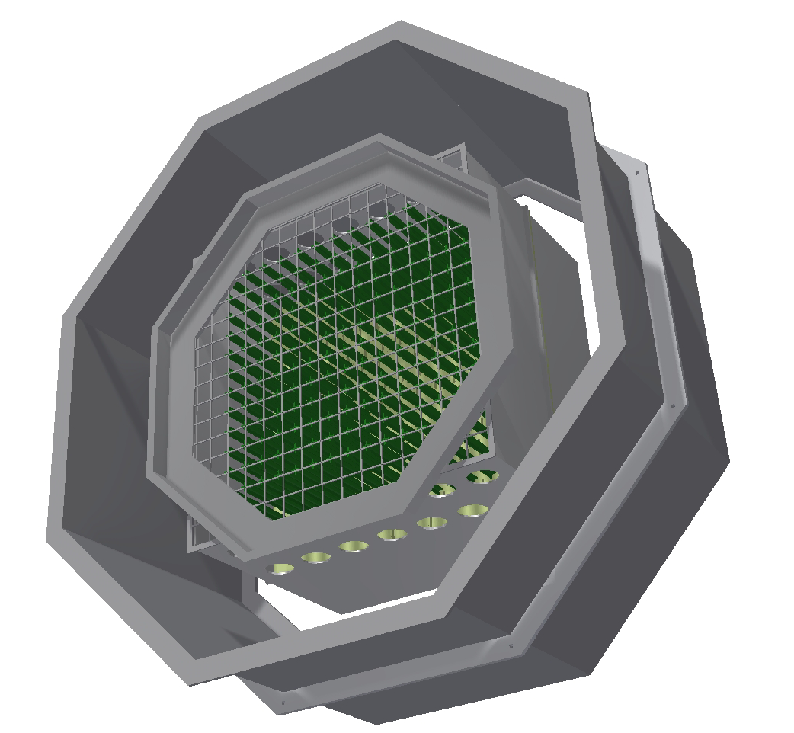
Camera - Primary Geometry
Total estimated weight – 646 kg (1424 lbs.) Bounding Diameter – 1.75 m (68.7”) Length - 0.91 m (36.0”)
Inner structure/sensor modules – 357 kg
Outer structure/adjust mech. - 289 kg
Drawer Structure
Inner Enclosure
Setback
Outer Enclosure
Inner Enclosure
Main Box
Mount Flange
Bulkhead

Slide 3
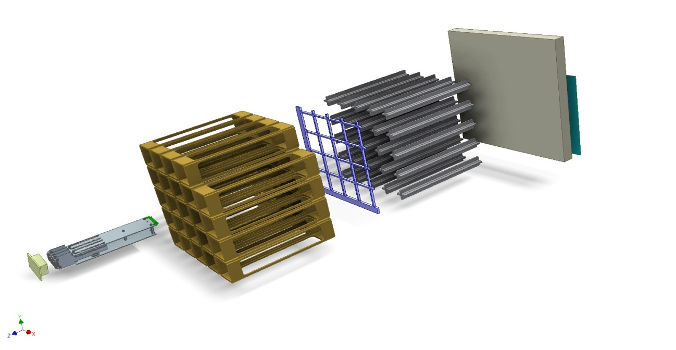
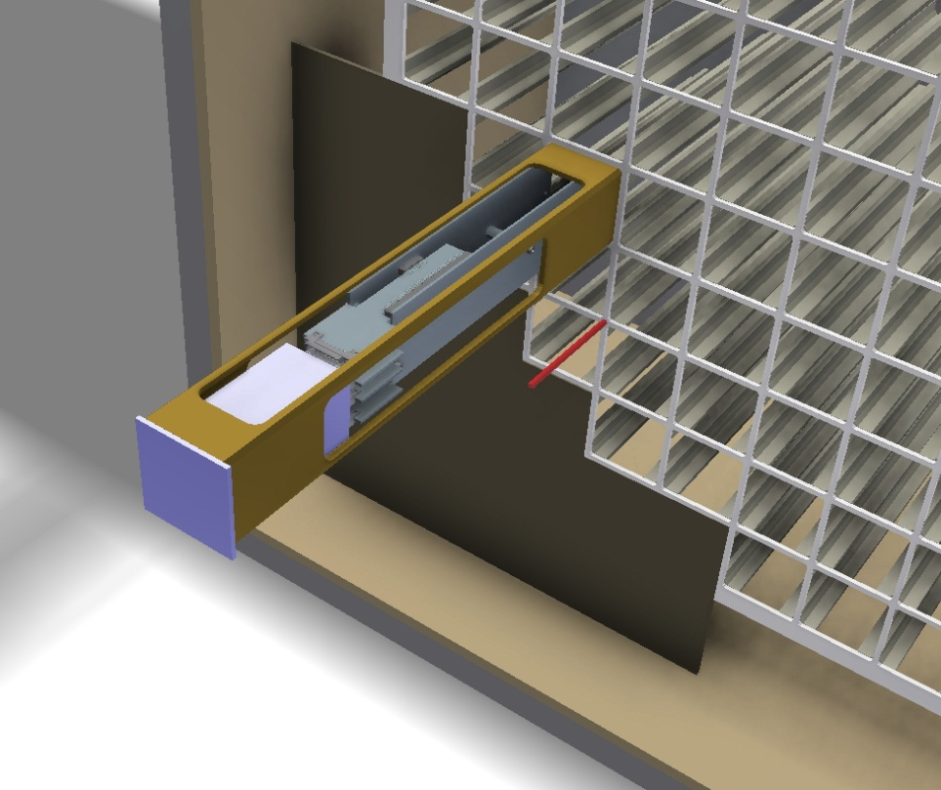
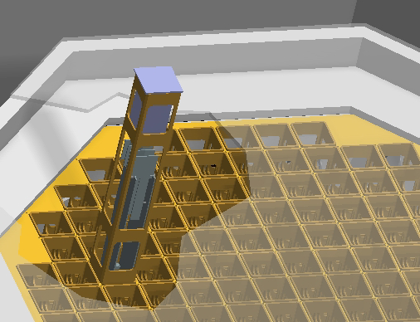
Motherboard
Cage
FEE
Post
Bulkhead
PreAmp
Sensor
Lattice
Sensor/FEE/Cage/Drawer Structure (Present concept)
Considering Heat pipe imbedded in Post

Slide 4
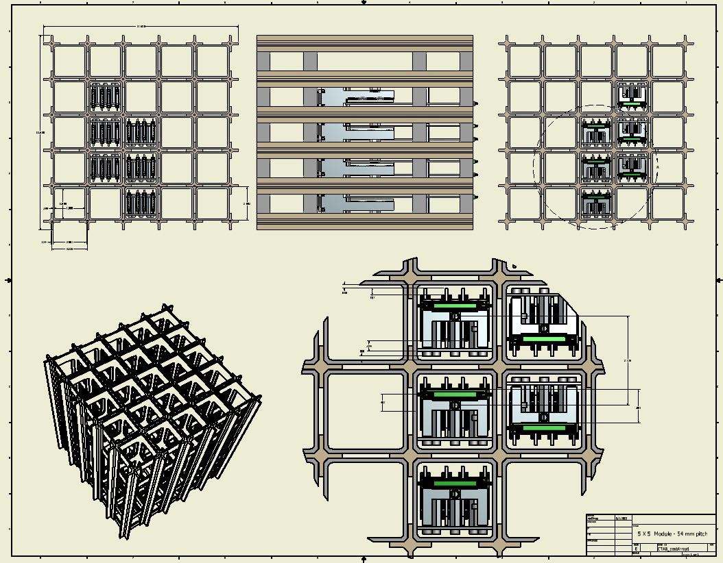
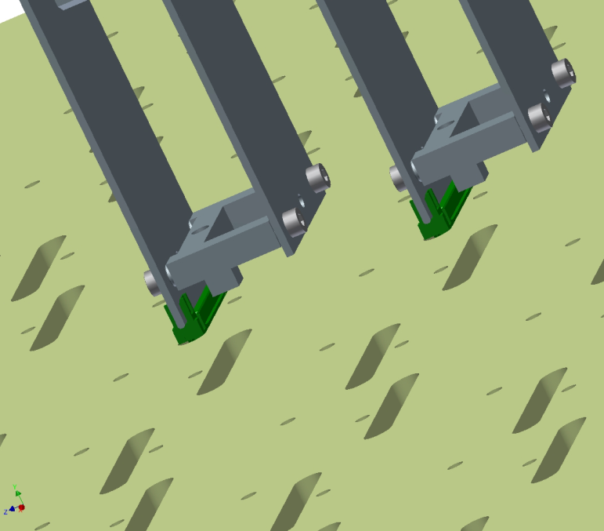
52mm – 54mm – 56mm – 54mm – 56mmfront / 54mmback Pitch History
Flip Concept
Bulkhead/Sensor/FEE/Cage /Motherboard Interface
Locating Pin – Inject/Eject

Slide 5
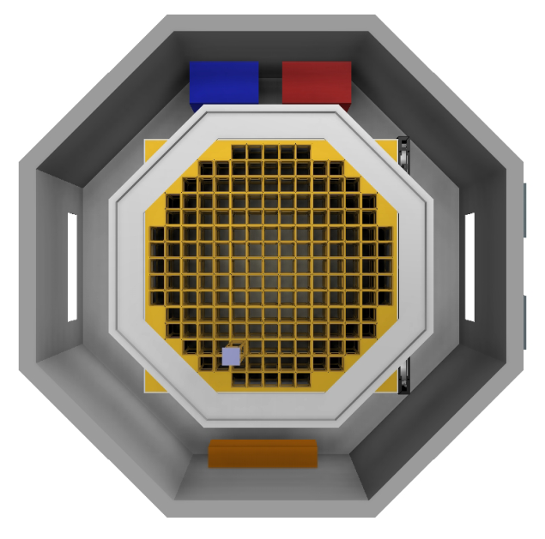
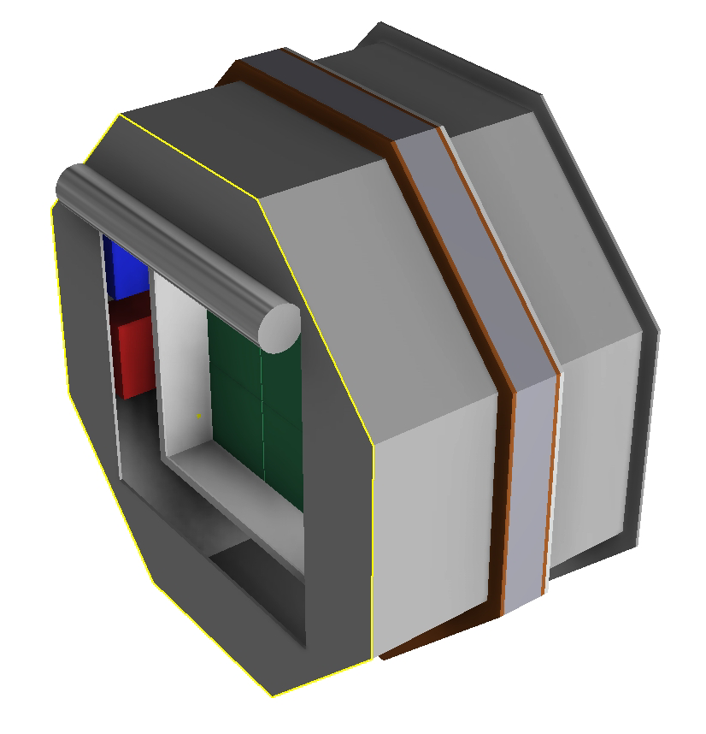
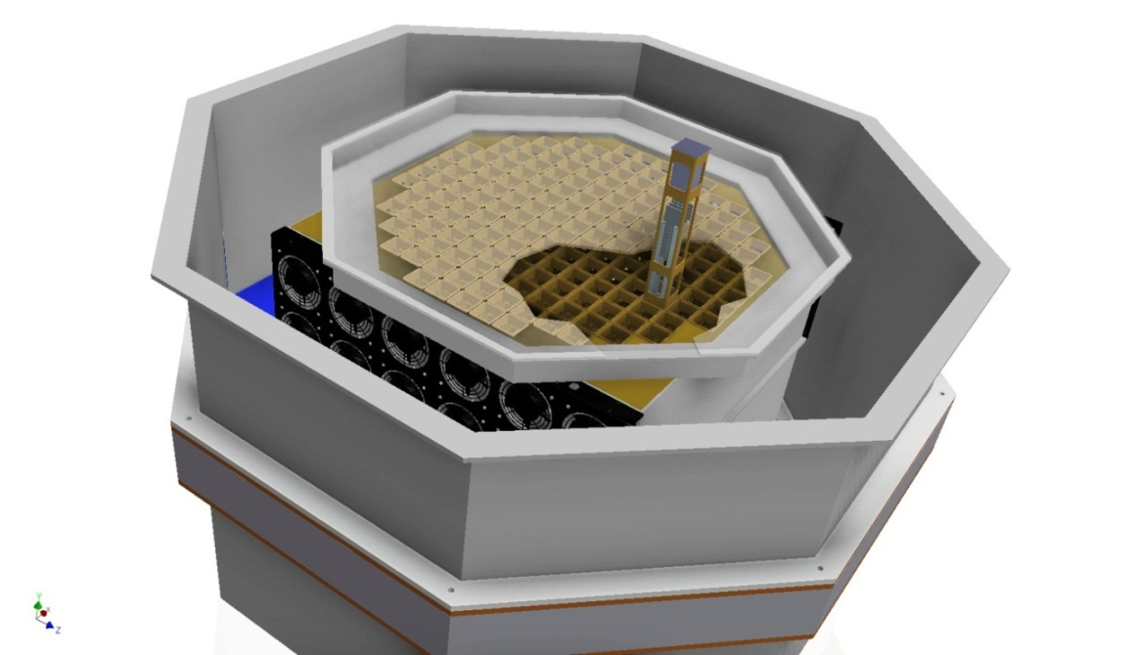
Camera Front
Showing Fans ,Telescope mount Ring,& Power supplies
Camera Back
Showing Rolling rear door

Slide 6
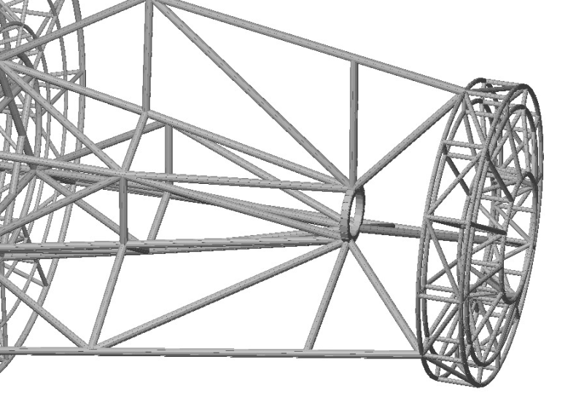
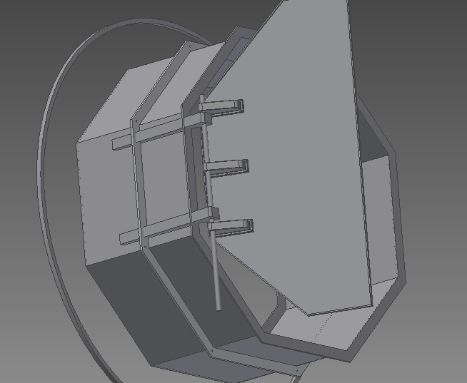
Camera Mount Ring
Propose 3 Point Mount
Structure mount impact on Shutter Design

Slide 7
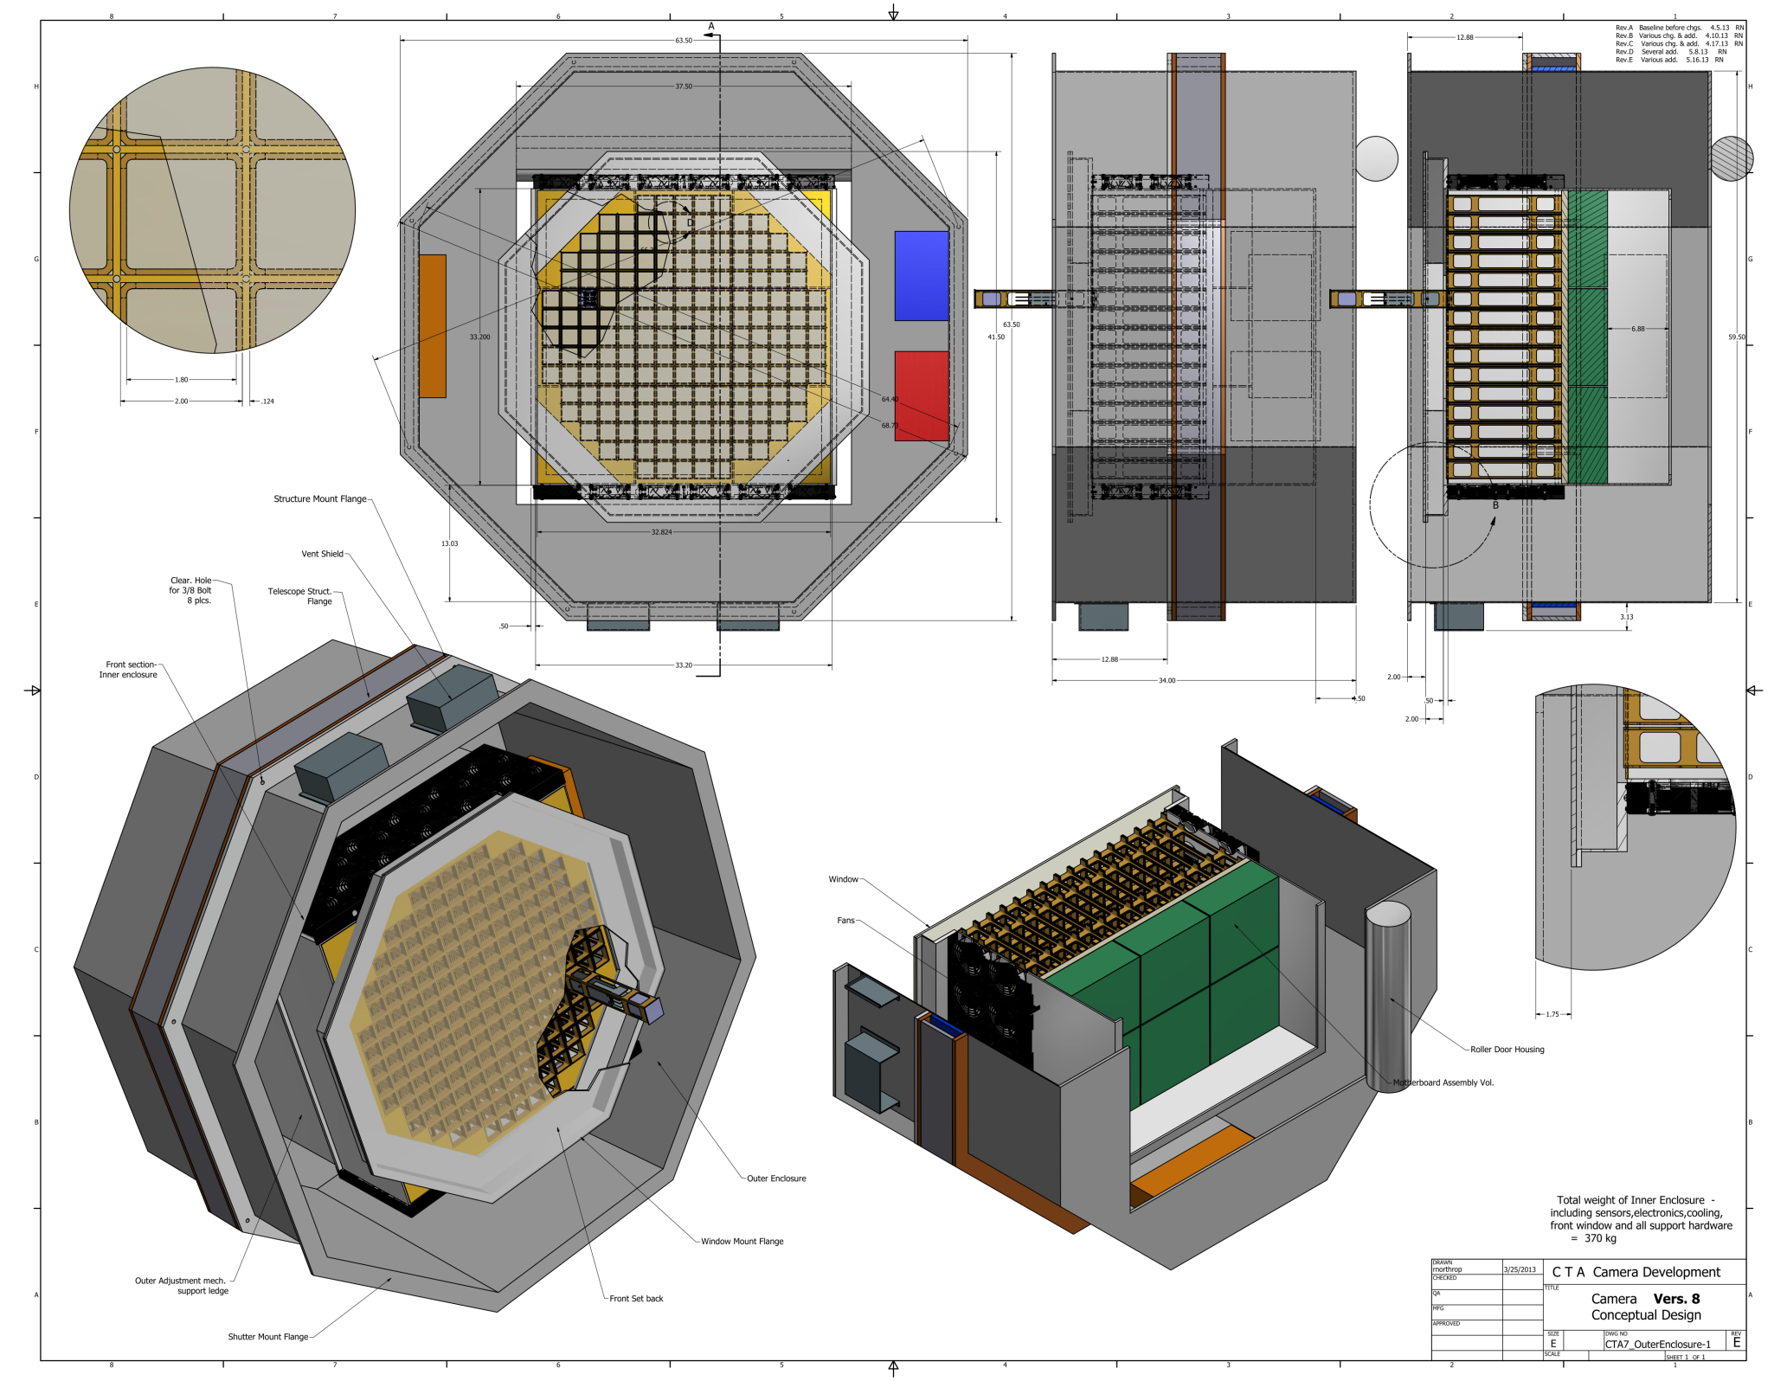

Slide 8
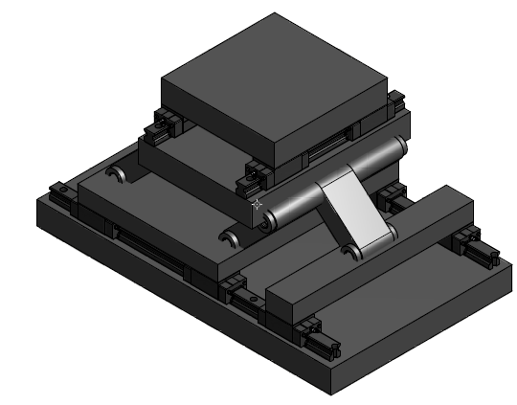
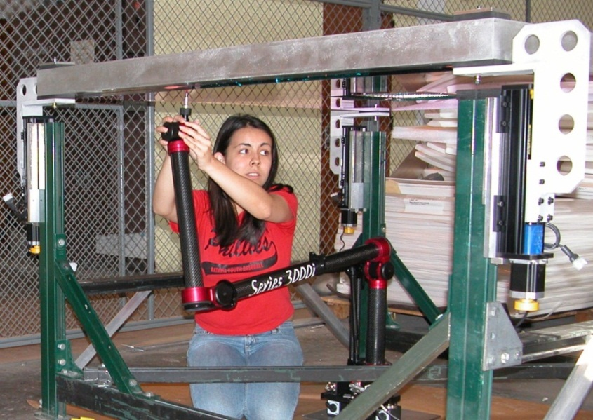
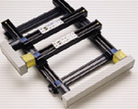
Camera Adjustment Mechanisms
X-Y-Z High load capacity – very accurate – very expensive
UC Trice Primary mirror Z-stage adjustment + - .002
Standard X – y stages - many options

Slide 9
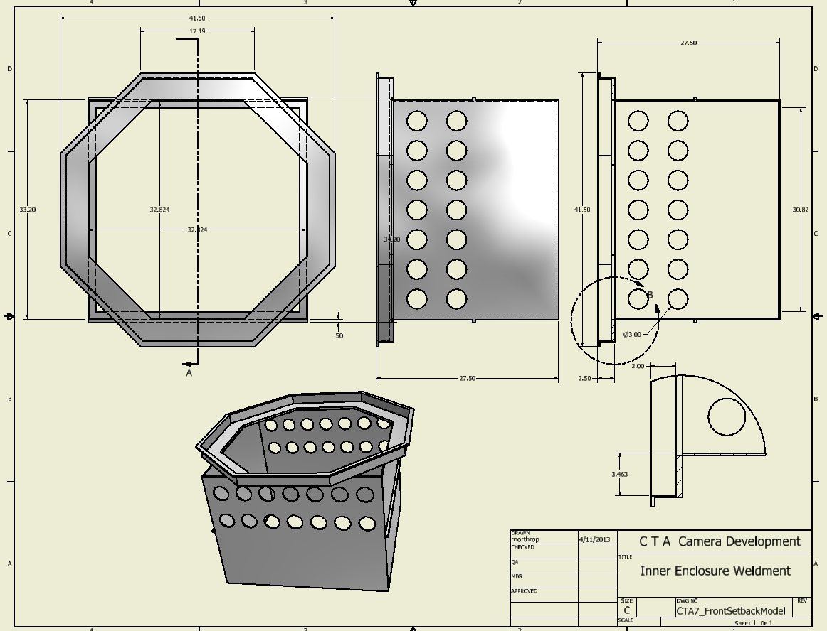

Slide 10
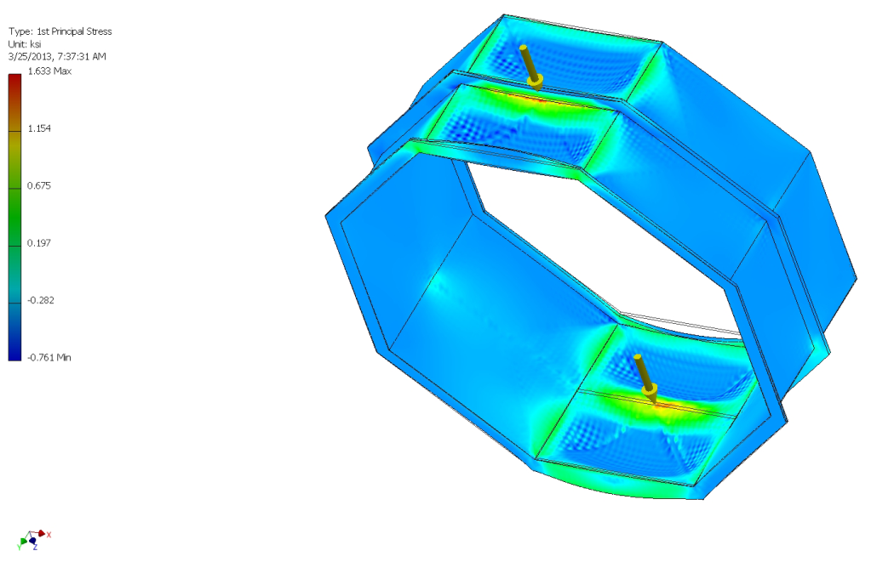
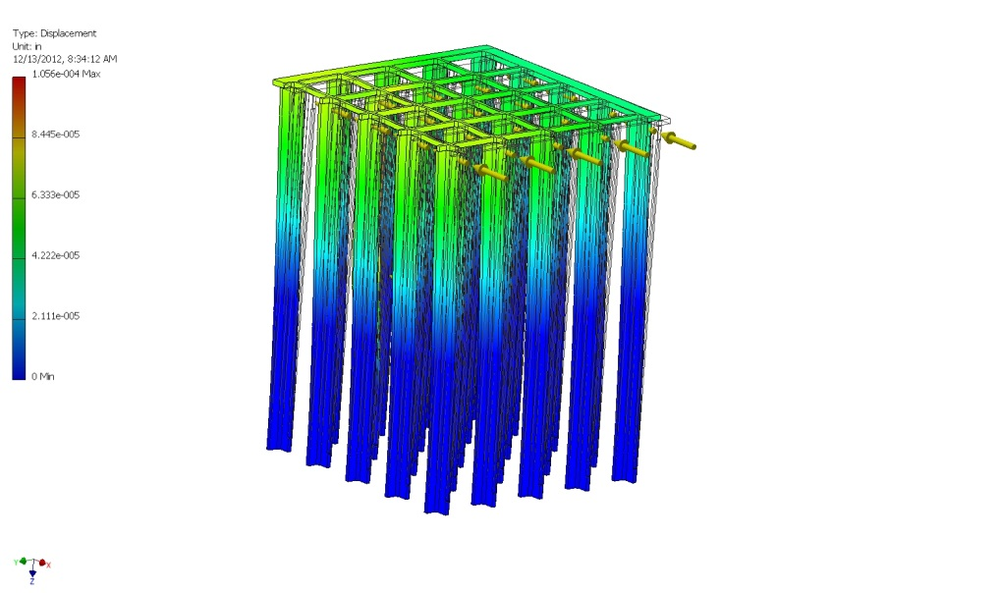
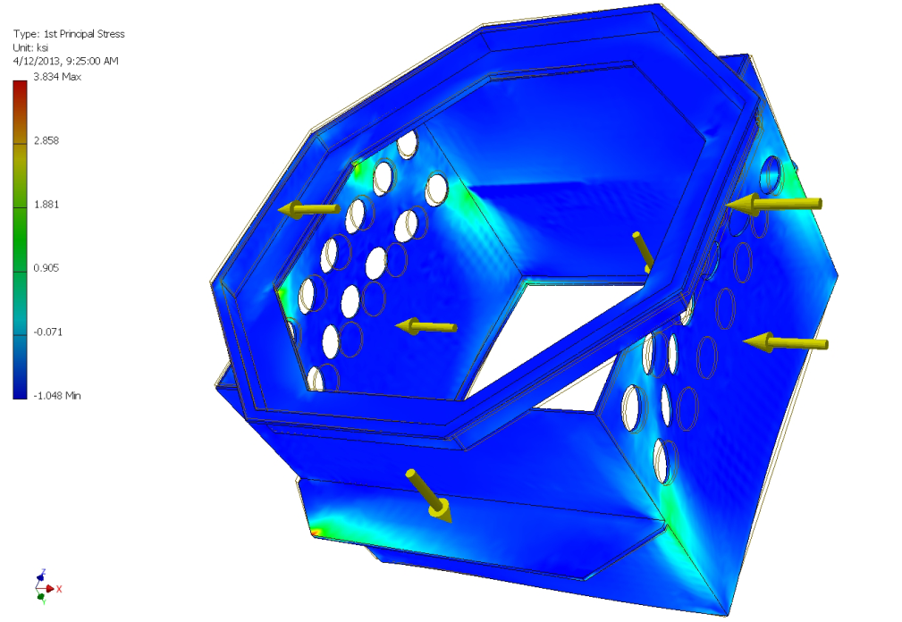
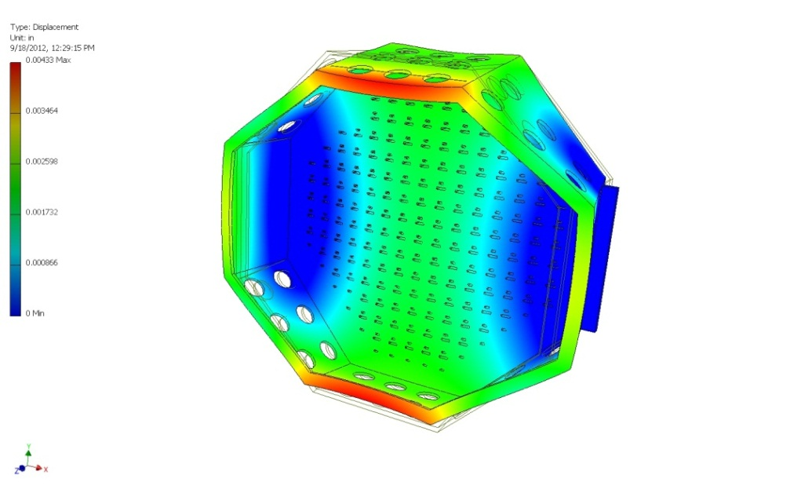
.0002” under 25 lb. top load
Low wall stress under estimated actual loading - need study with adjustment and mounting attachments
.0017” under 300 lb. UDL
Stress studies of selected structure components

Slide 11
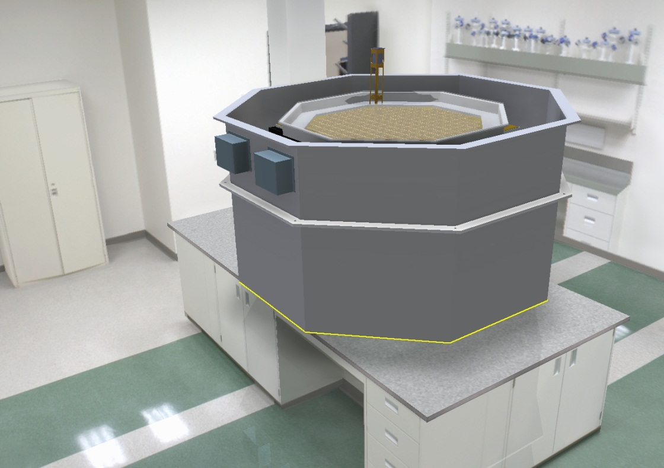
Camera Assembly at University of Chicago
Scheduled February 2014

