Slide 1
C T A Camera Development
Mechanical
Rich Northrop University of Chicago
Rome, Italy Meeting October 25 - 26, 2012

Slide 2
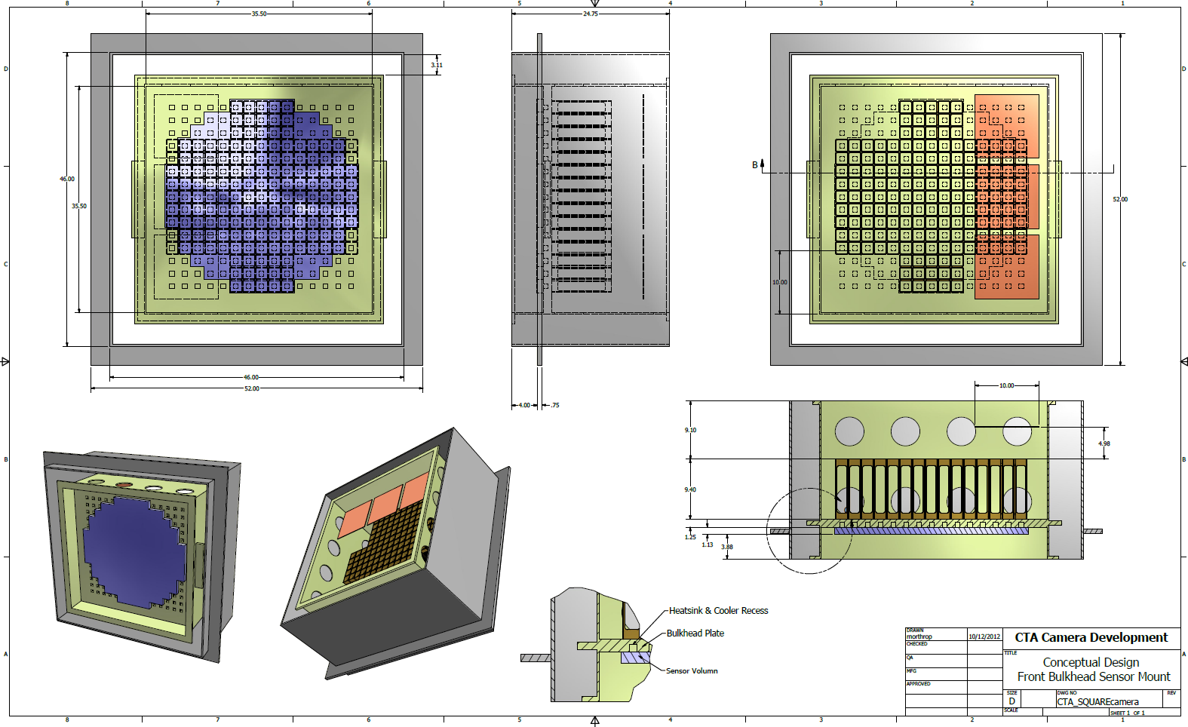
Front Bulkhead Mount Concept

Slide 3
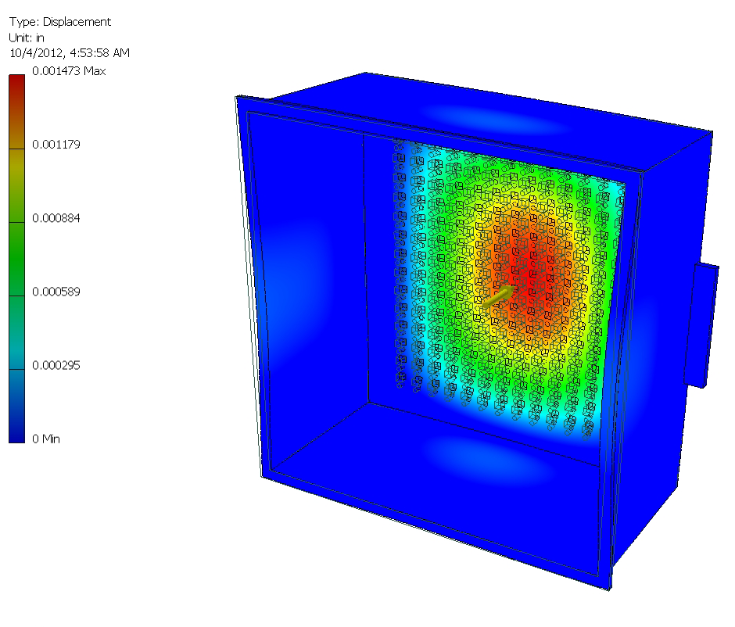
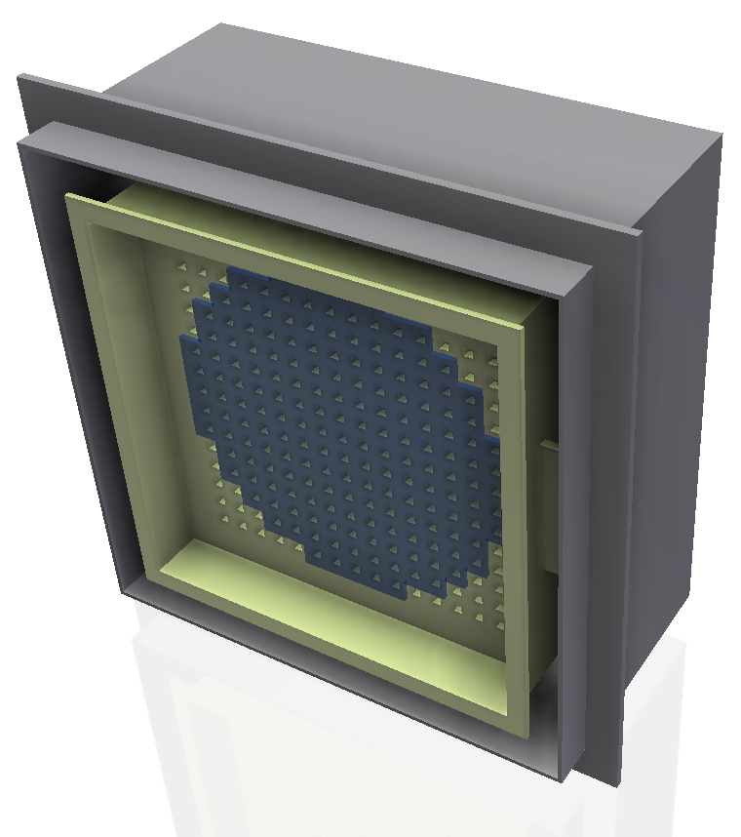
Front Bulkhead Mount Deflection with 600 lb. UDL Loading

Slide 4
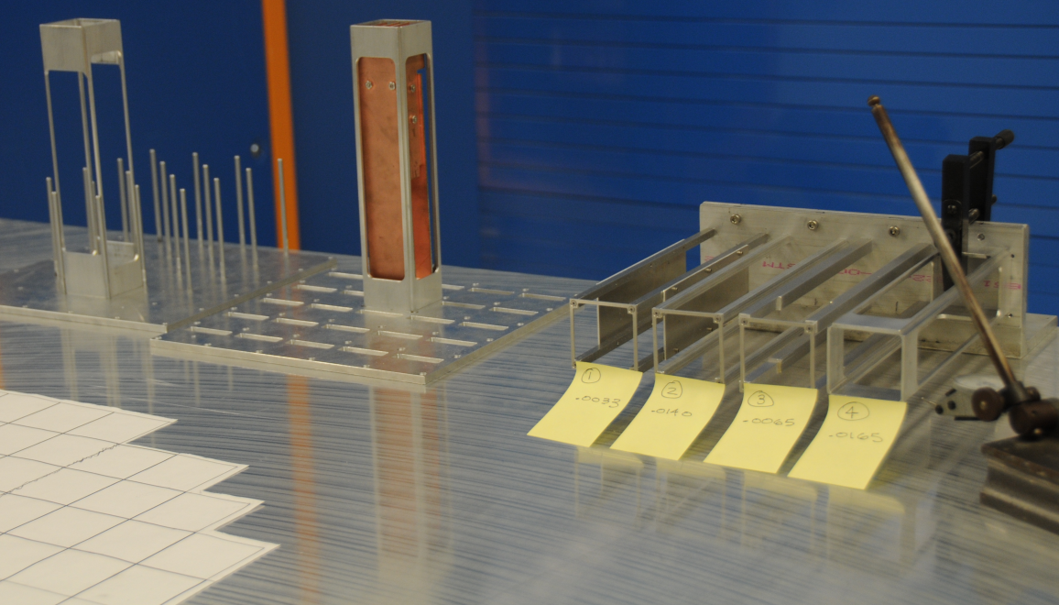
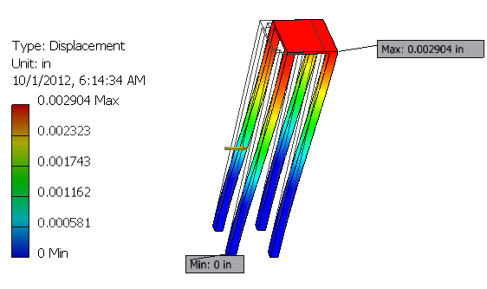
FEE / Cage Prototypes Deflections with 2 lb. UDL

Slide 5
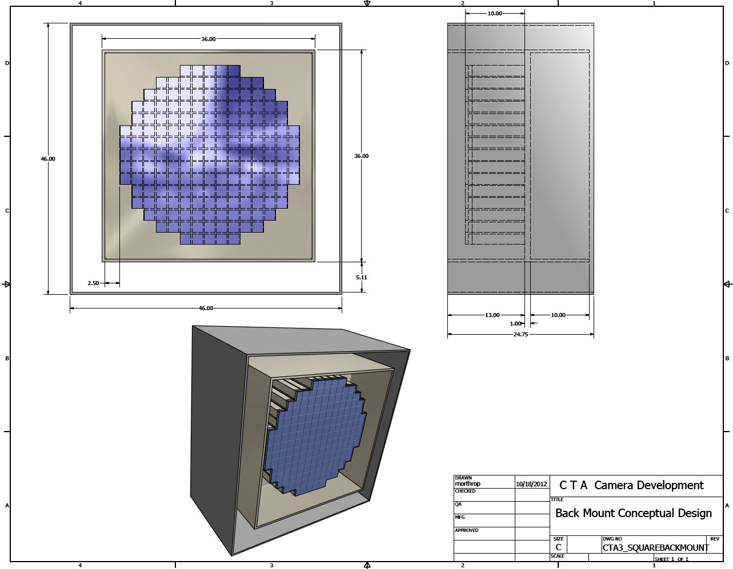
Rear Bulkhead Mount Concept

Slide 6
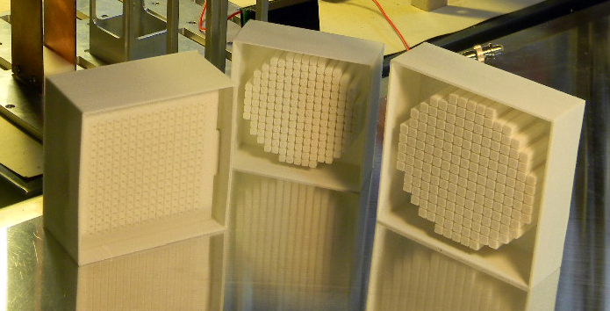
Camera 3D Prints 1/8 & 1/10 scale

Slide 7
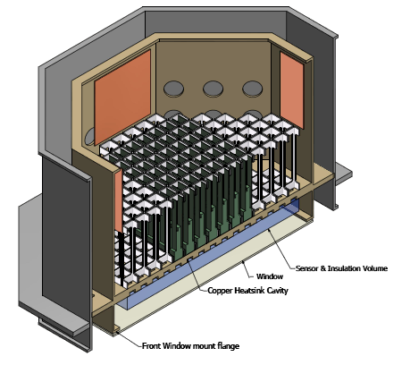
Section View of Early Octogon Camera Concept

