Slide 1
C T A Camera Development
Mechanical
Rich Northrop
University of Chicago Meeting September 28, 2012

Slide 2
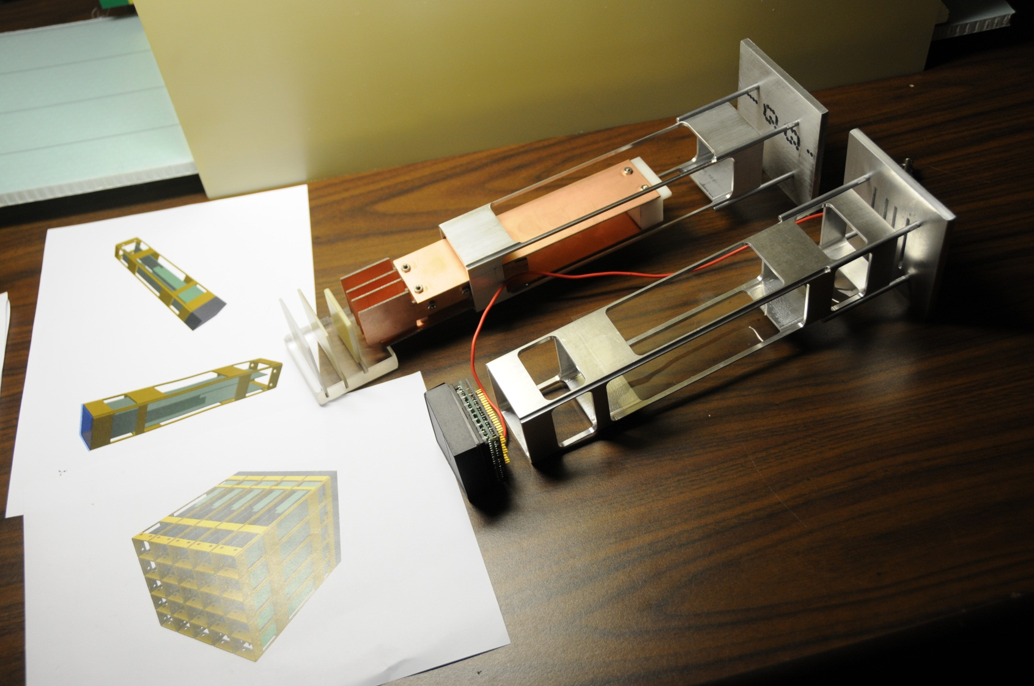
First Sensor / Module Designs and Mockups

Slide 3
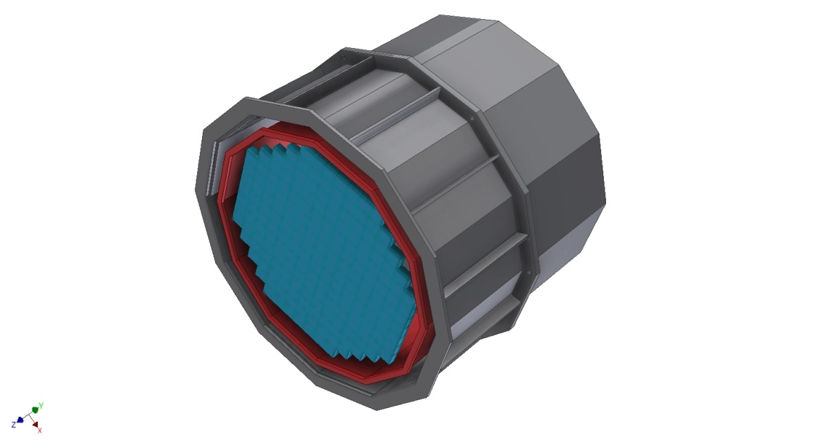
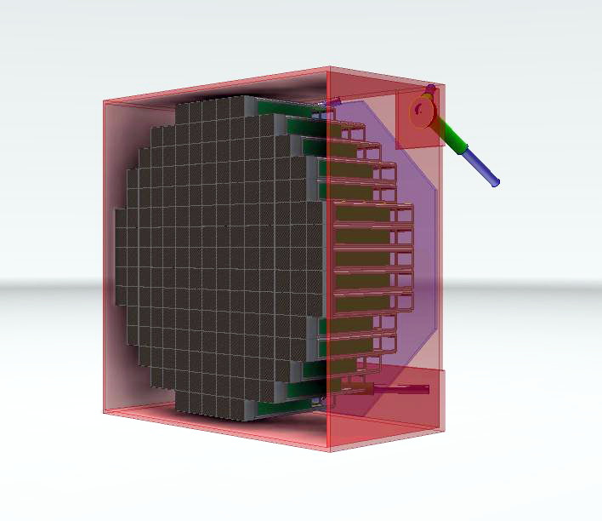
Two Early Camera Conceptual Designs

Slide 4
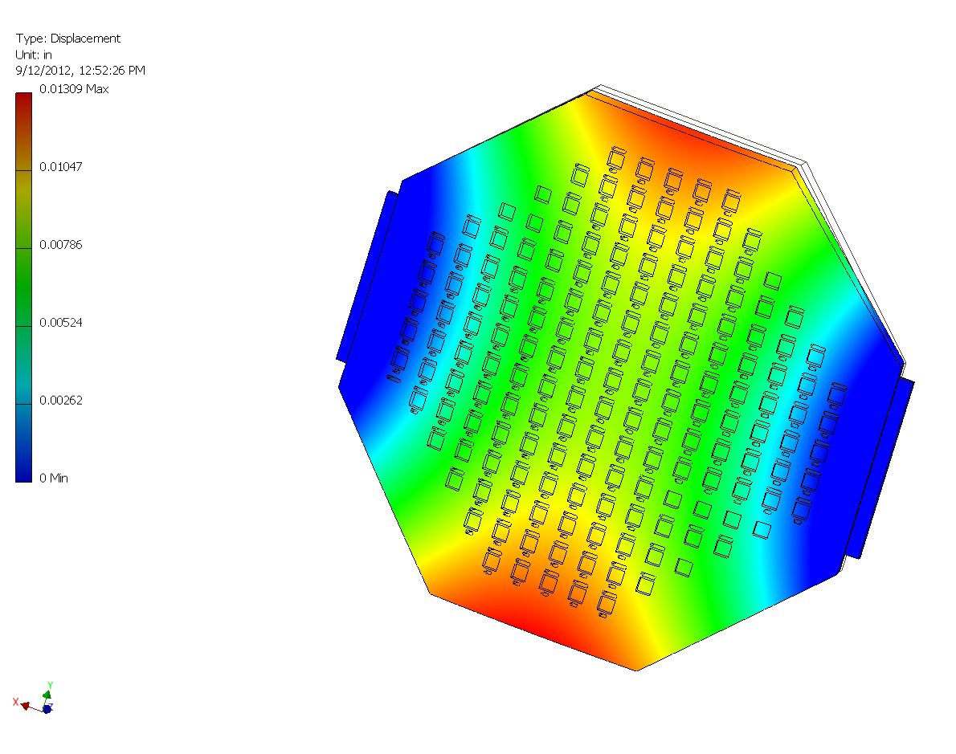
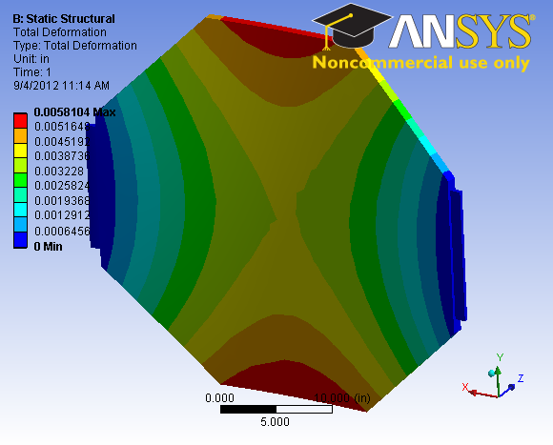
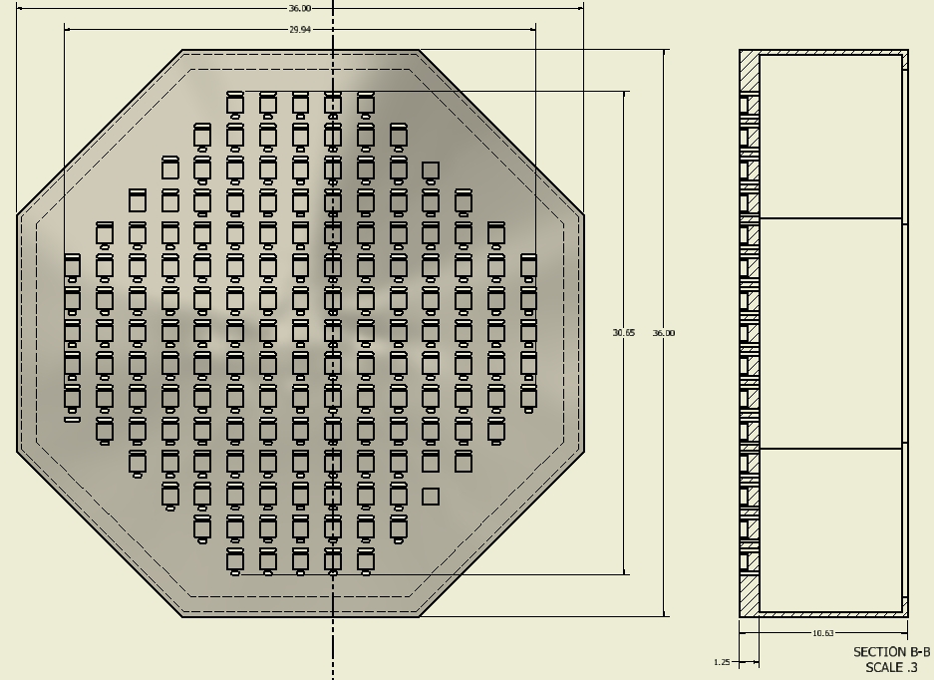
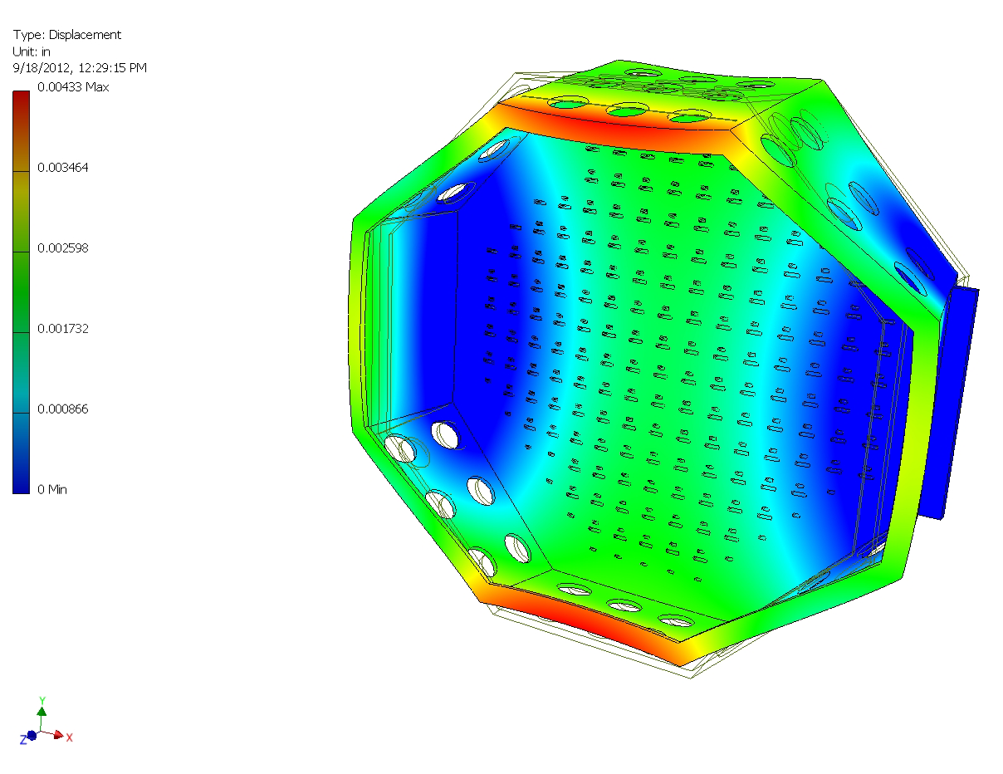
Bulkhead Plate and Inner Enclosure Early Design & Analysis

Slide 5
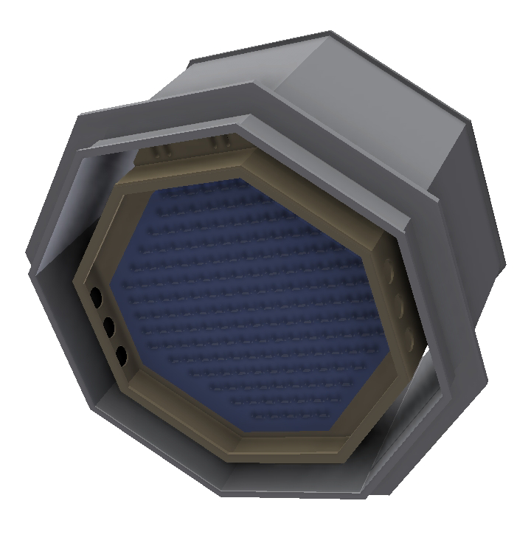
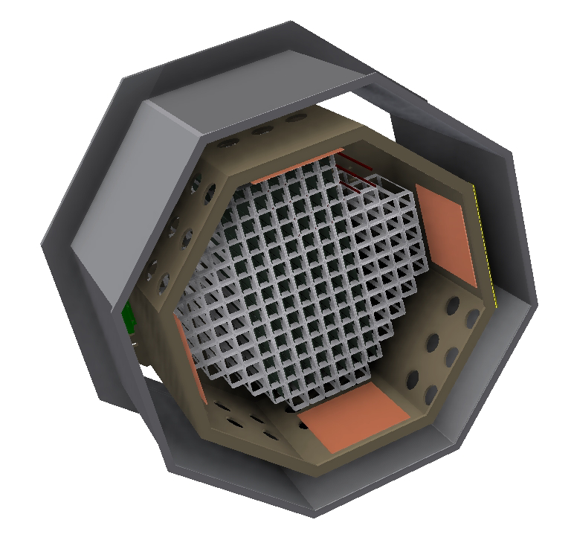
Conceptual Design for Camera / Inner & Outer Enclosures

Slide 6
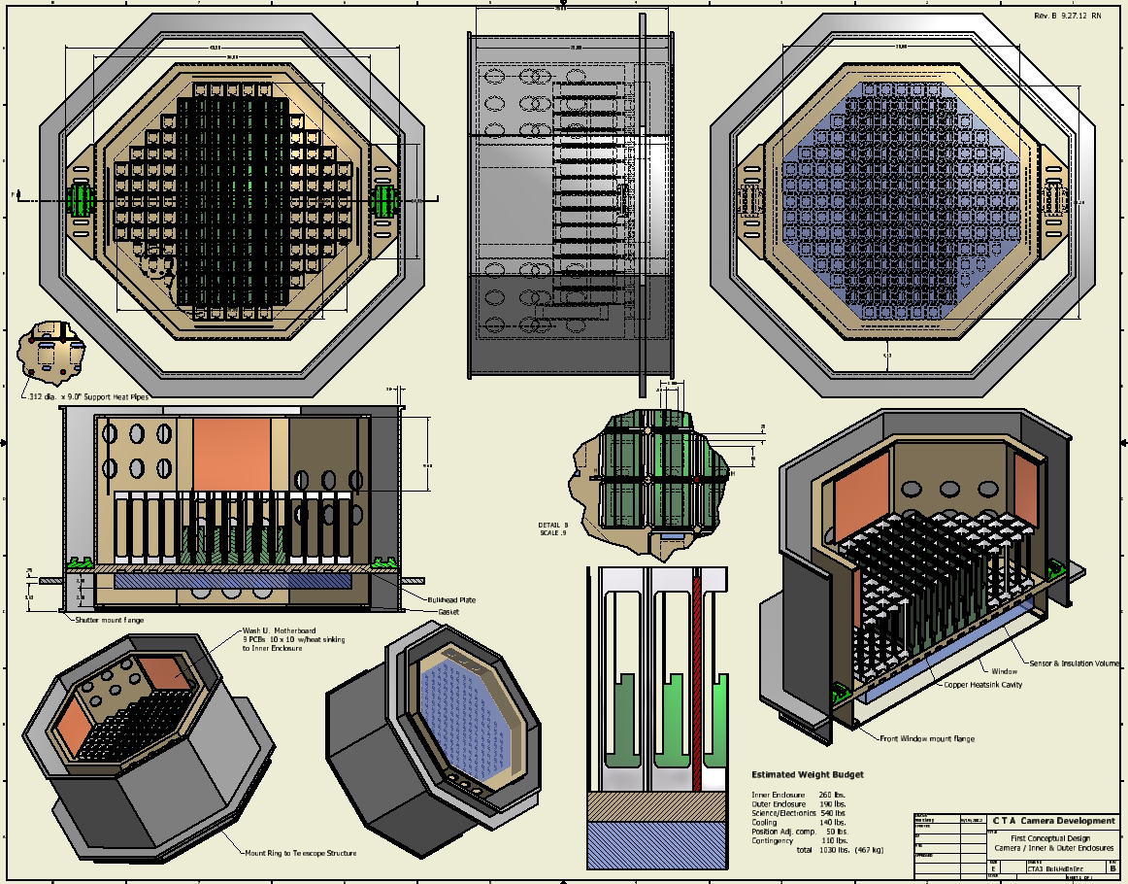

Slide 7
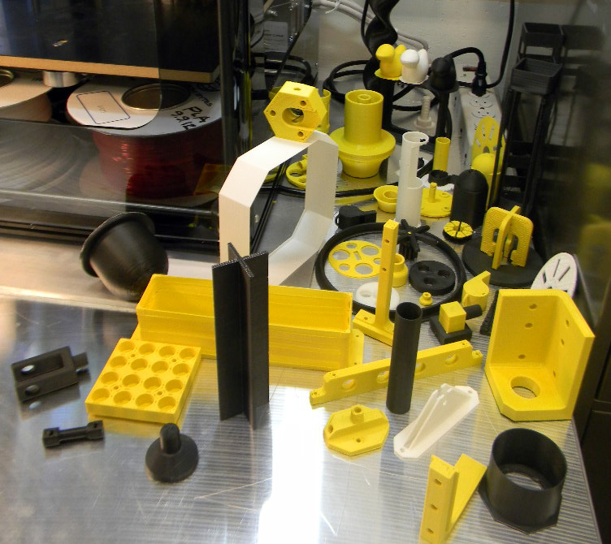
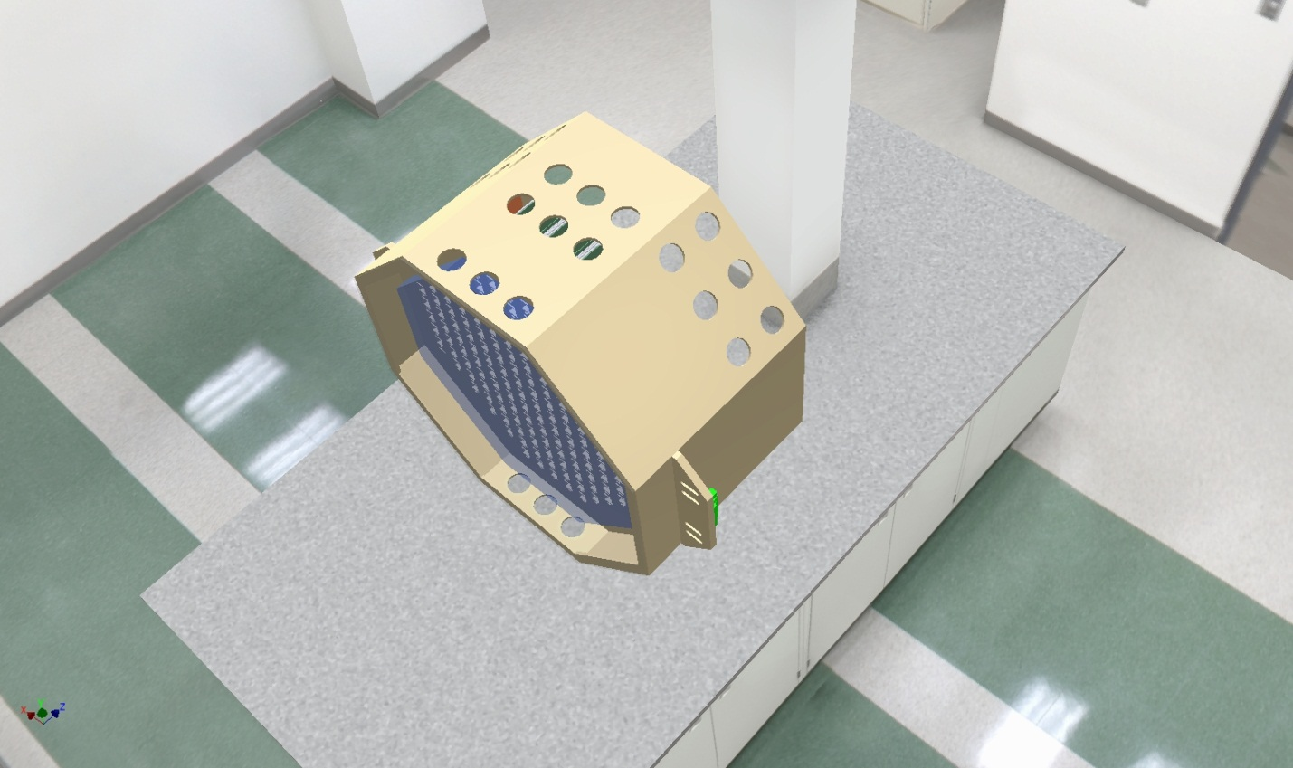
Capacity to make scale model of camera

