Slide 1
C T A Camera Development
Mechanical
Washington University September 9 – 10 2013
Rich Northrop University of Chicago
Rev B

Slide 2
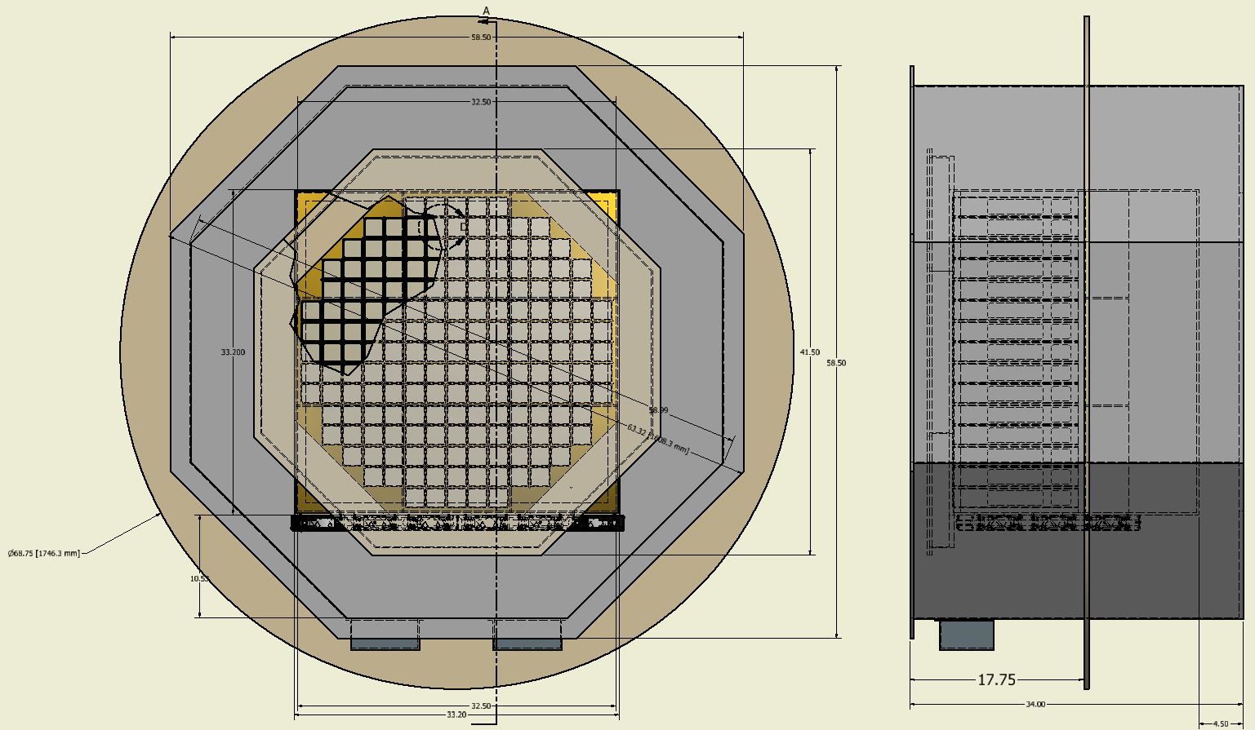
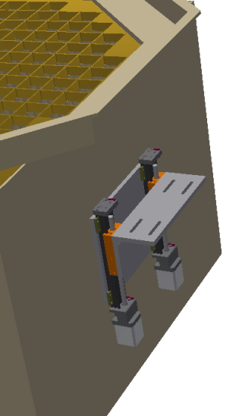
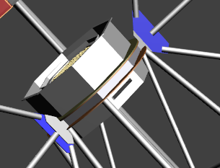
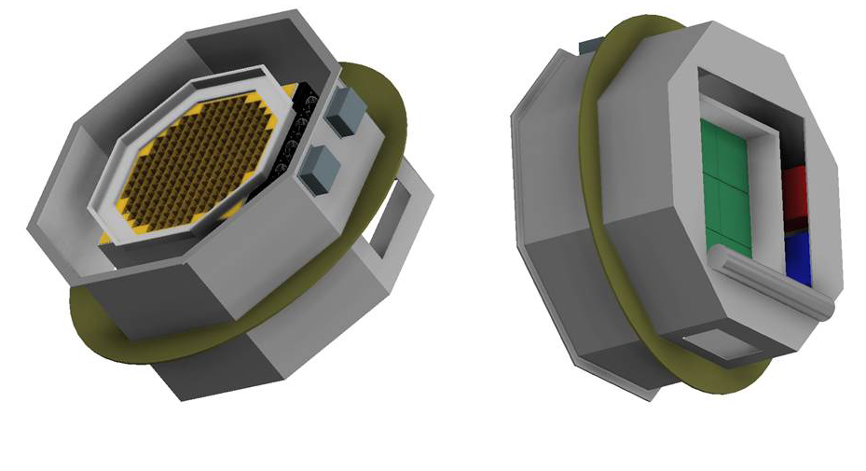
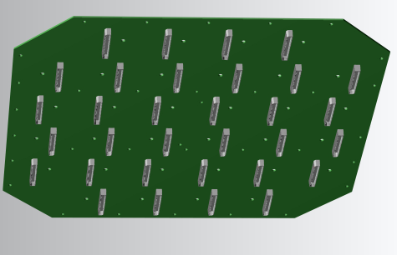
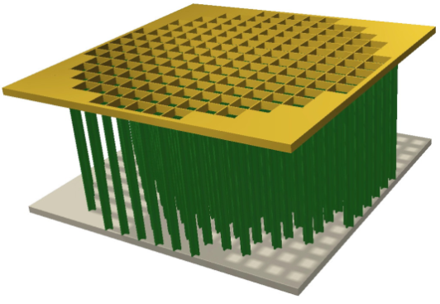
D
B
A
C
E
F
H
G
Major Mechanical Concerns

Slide 3
Concerns –
200 Micron Location Demand on Sensors
Final Camera Size (based on new shadowing analysis)
Bulkhead Design & Details
FEE to Cage Mounting
Sensor/Cage/Bulkhead Mounting (location & locking)
Thermal Impact on Rack & Components
Camera Positioning - Z motor driven, X & Y manual
Mounting Flange Design

Slide 4
Need to Know –
Bulkhead Mounting/Penetration Requirements
FEE Details
Sensor Details
Final Shadowing Studies
Telescope/Camera Mount Ring Details
Camera Access

Slide 5
Solutions –
Final & Exact Bulkhead Layout
Precision Location & Locking Mechanism for Module/Sensors
Mounting Design for Cage/FEE/Bulkhead
Camera X Y Z Positioner Design

