Slide 1
C T A Camera Development
Mechanical
Rich Northrop University of Chicago
U C L A Meeting January 14, 2013

Slide 2
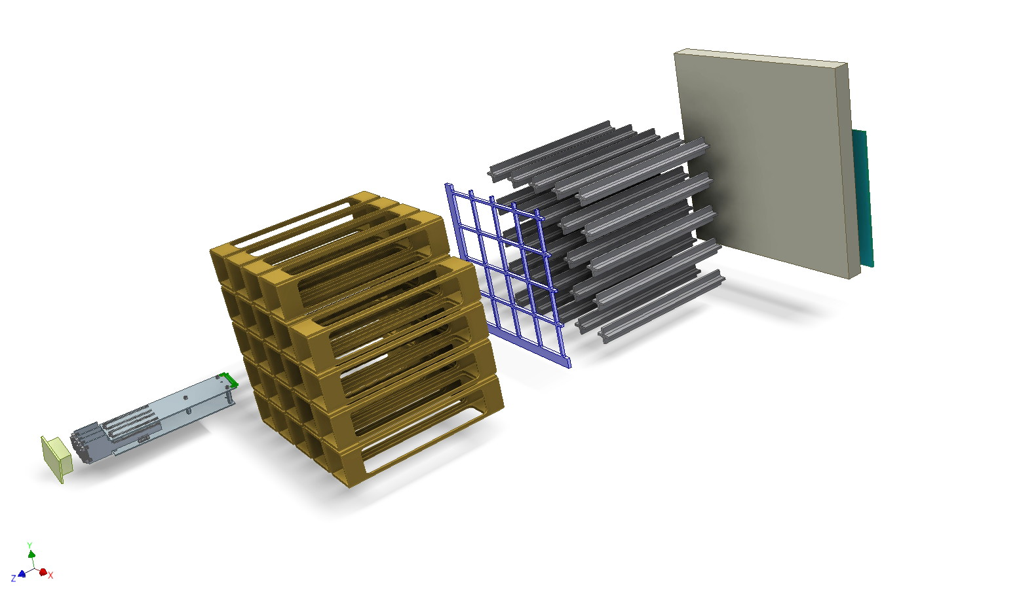
Concept of camera major parts

Slide 3
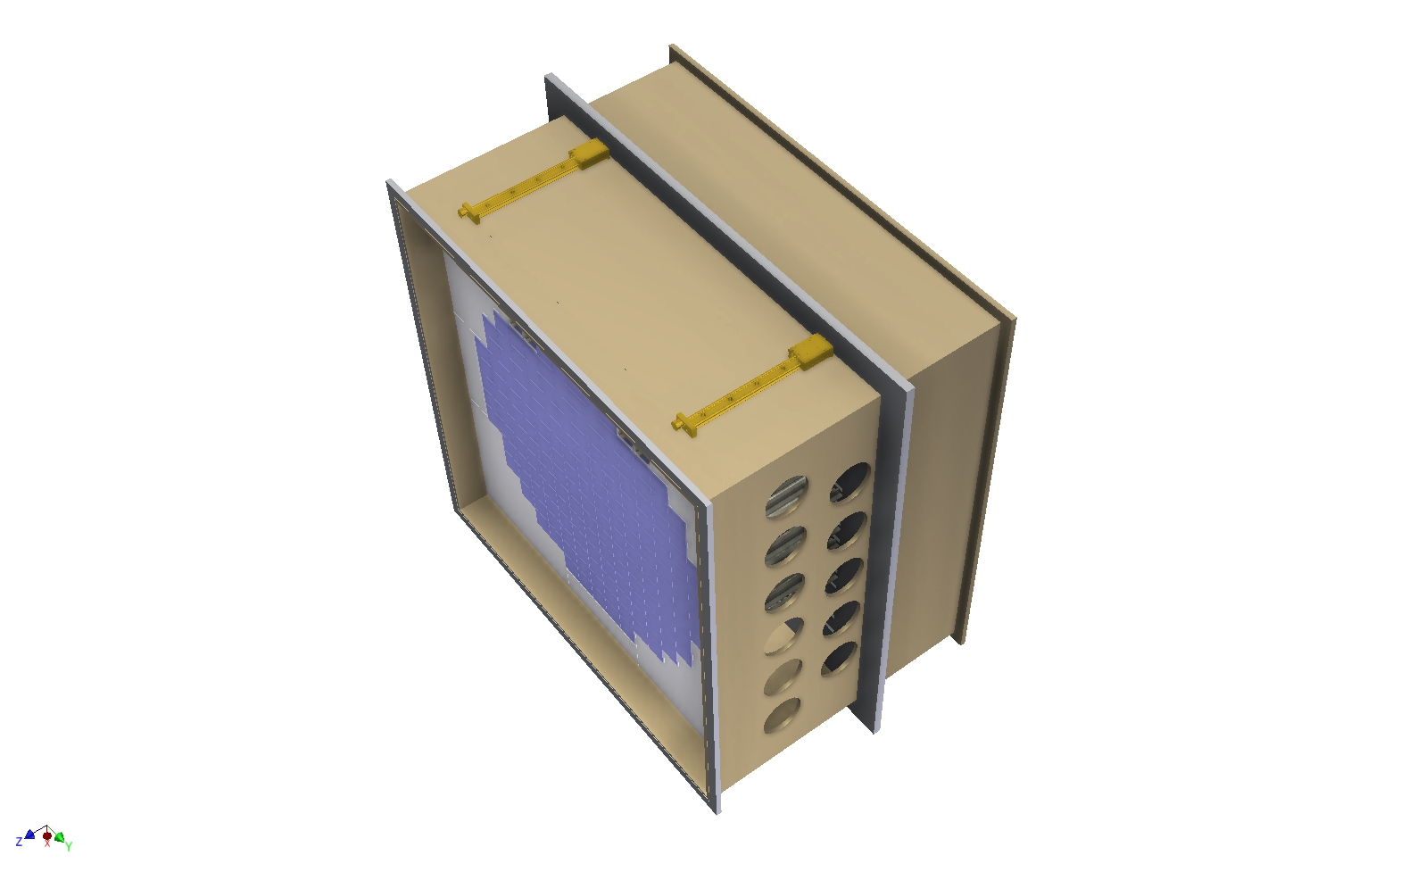
Inner enclosure design

Slide 4
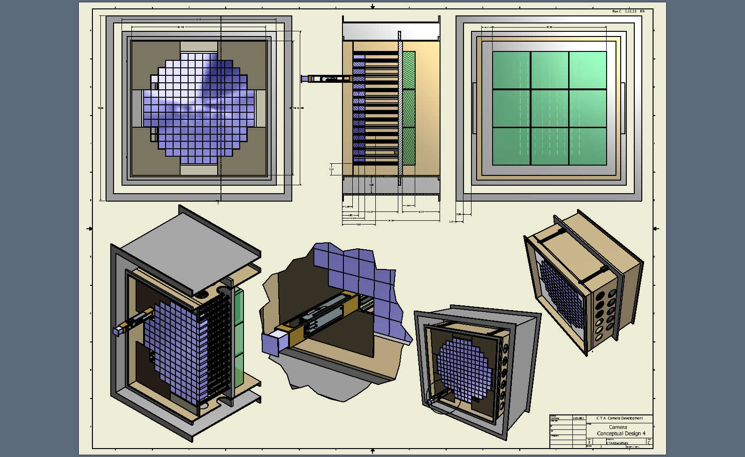
4th generation camera concept

Slide 5
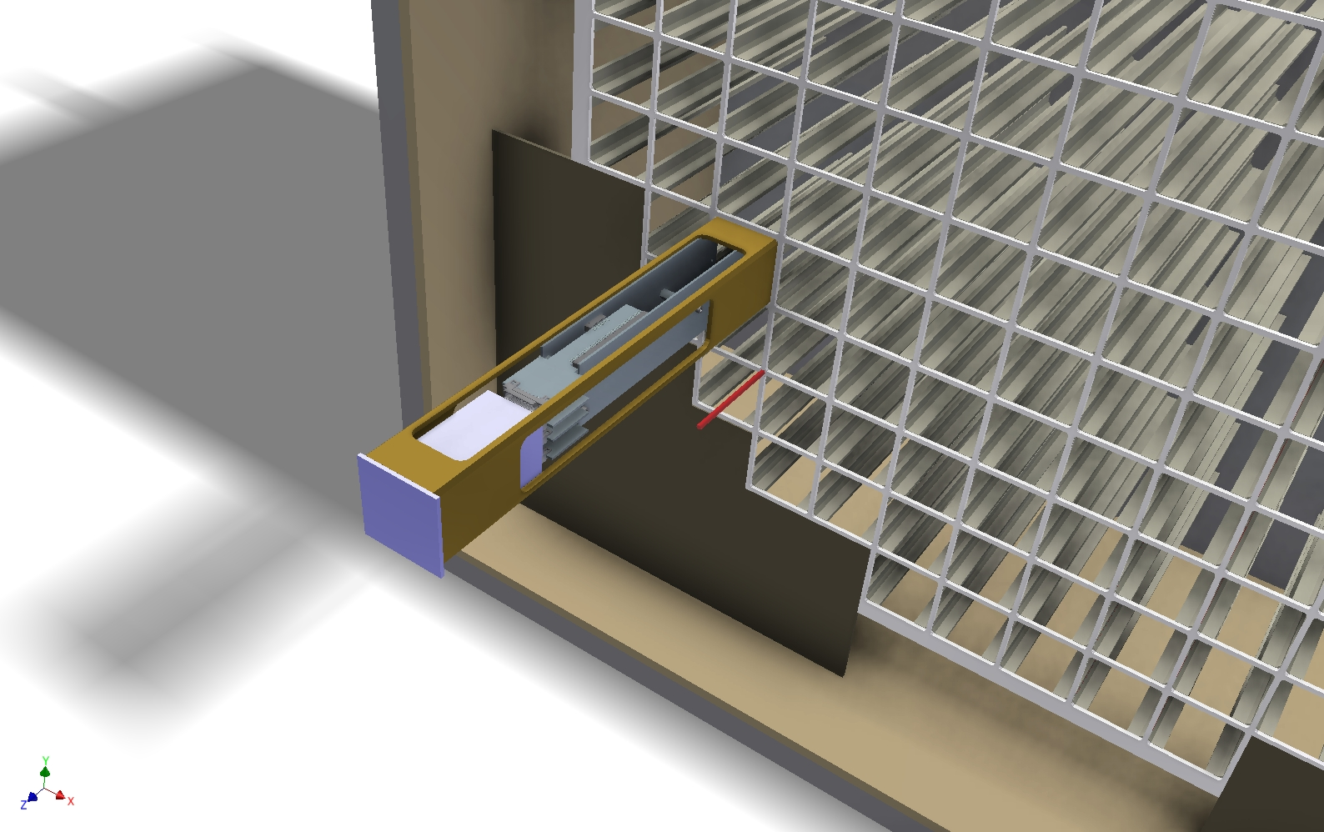
Close up of sensor/fee/positioning structure

Slide 6
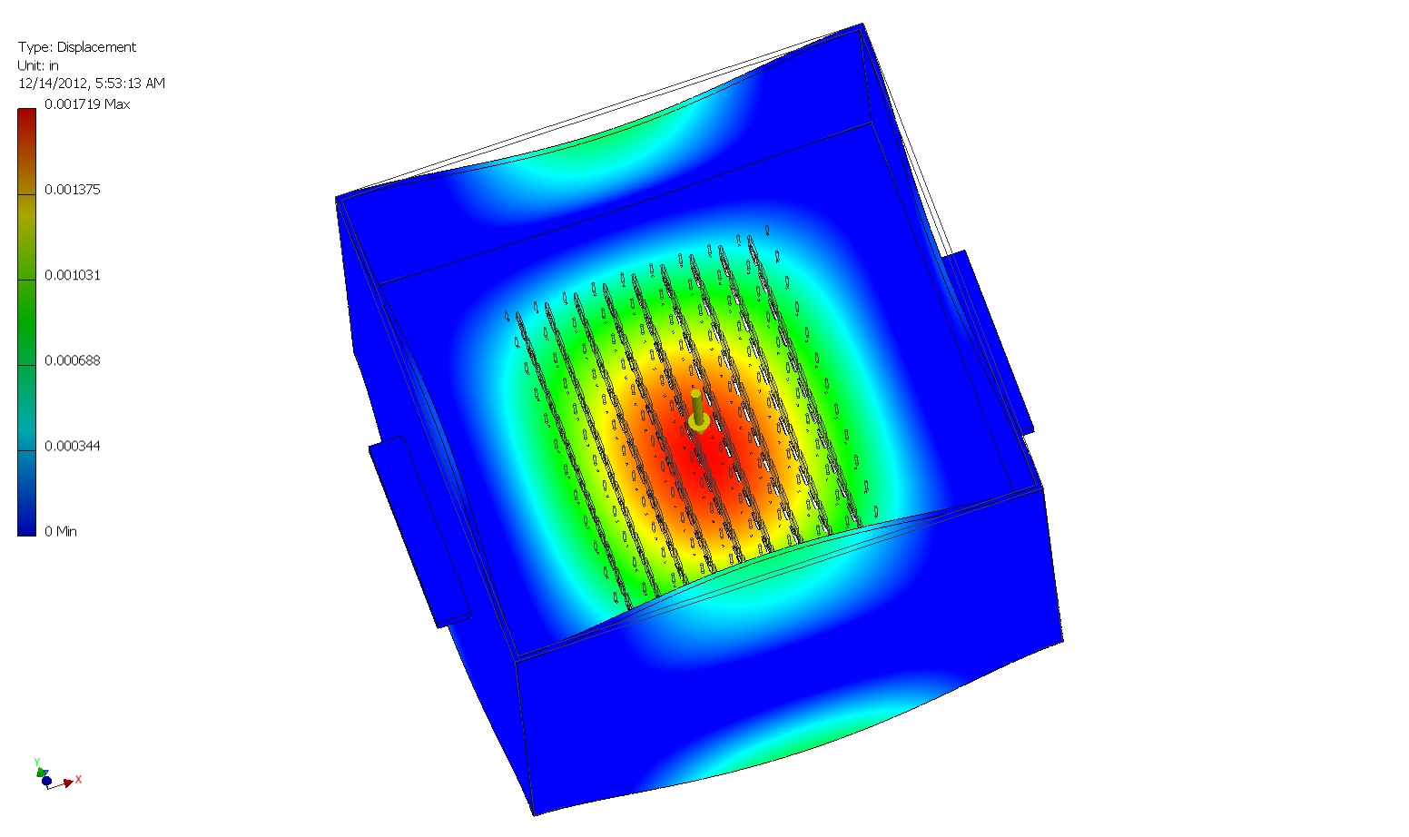
Deflection study of inner camera enclosure

Slide 7
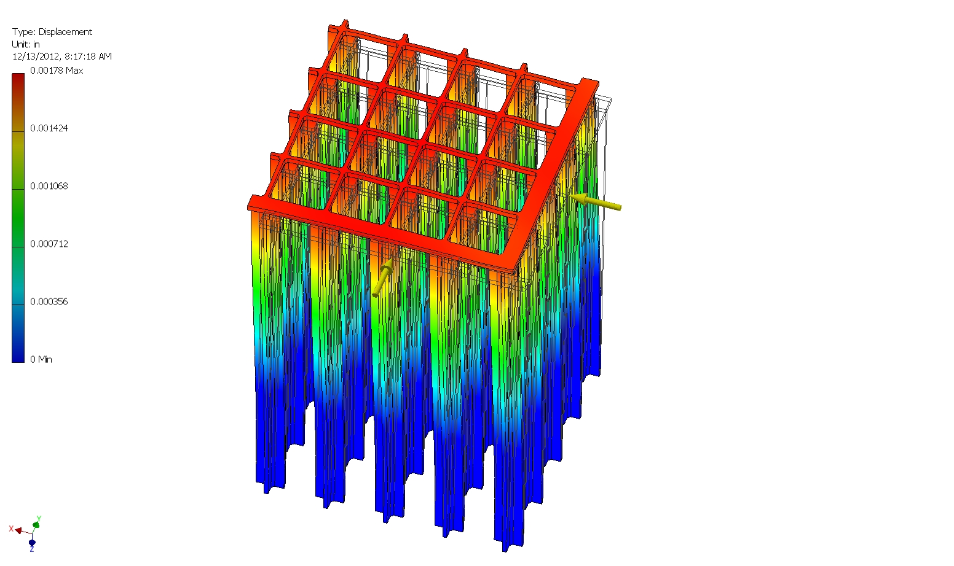
Deflection study of sensor support structure

Slide 8
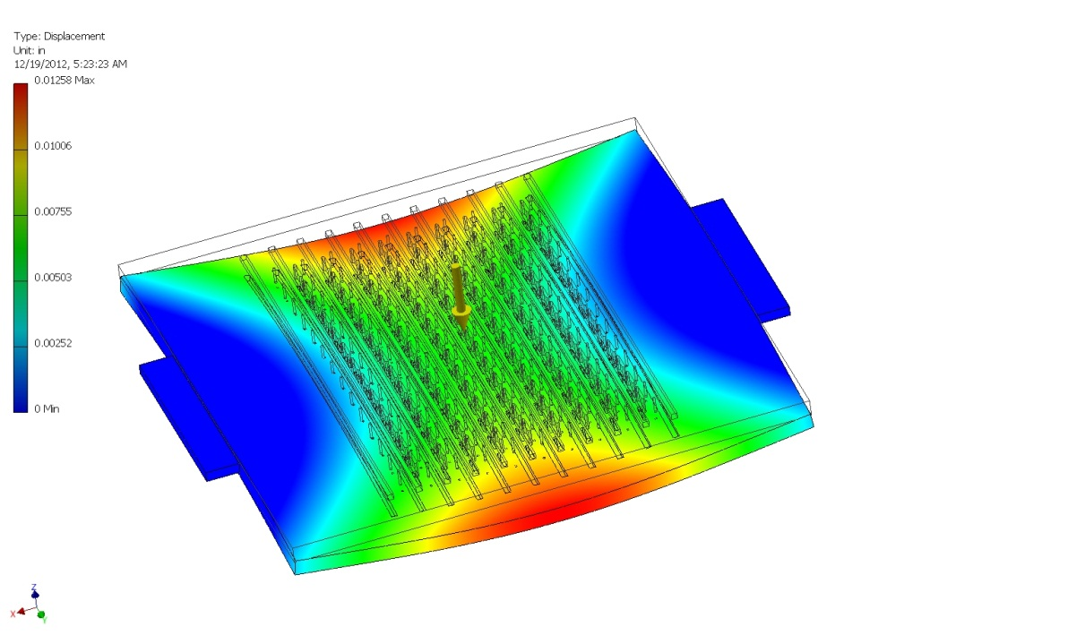
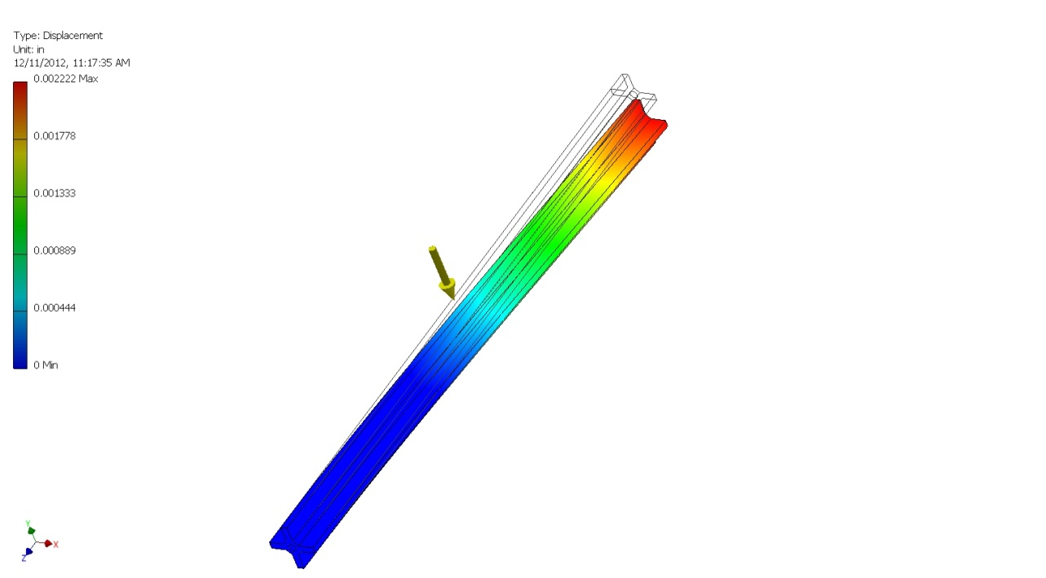
Component stress study

Slide 9
